Slide 1





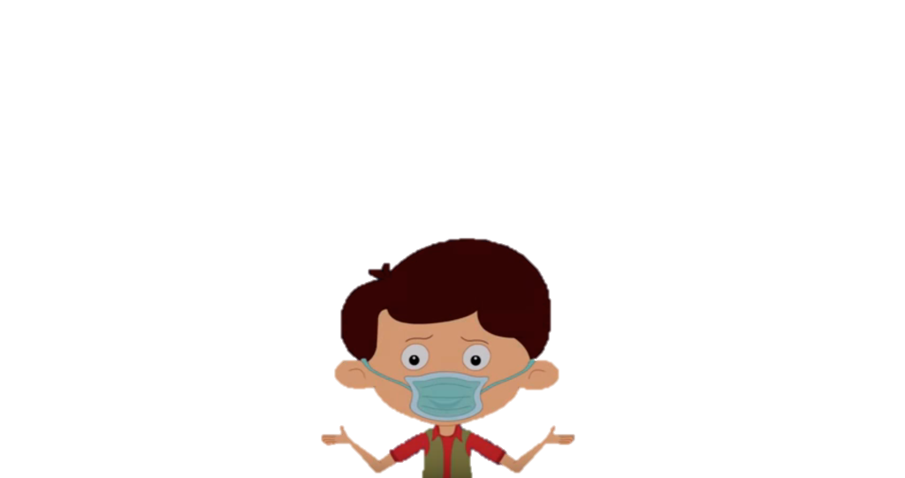
-By Jahanvi

Slide 2
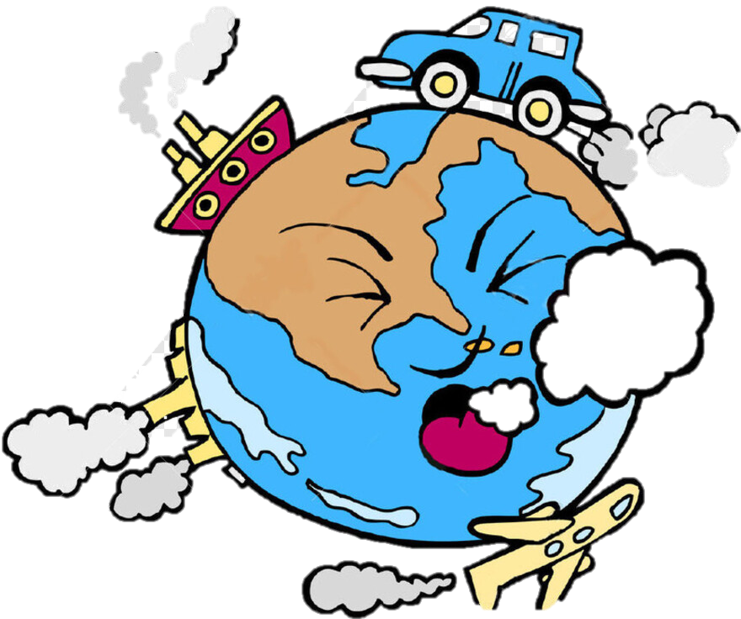
What is Air Pollution?
Any visible or invisible undesirable particle or gas
Found in the air that is not part of it’s original,
Normal composition.

Slide 3
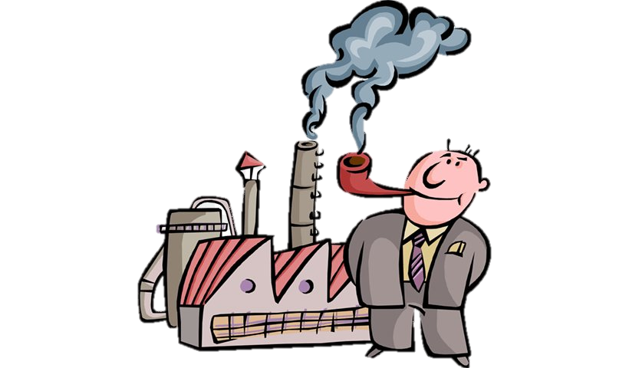
Causes of Air Pollution
Natural: Forest Fires, Pollen and Dust Storm.
Unnatural: Man-Made: Coal, Wood and Other Fuels
used in cars, homes and factories for energy.

Slide 4
Five Major Air Pollutants
Carbon Monoxide
Sulfur Dioxide
Nitrogen Dioxide
Particulate Matter
Ground Level Ozone

Slide 5
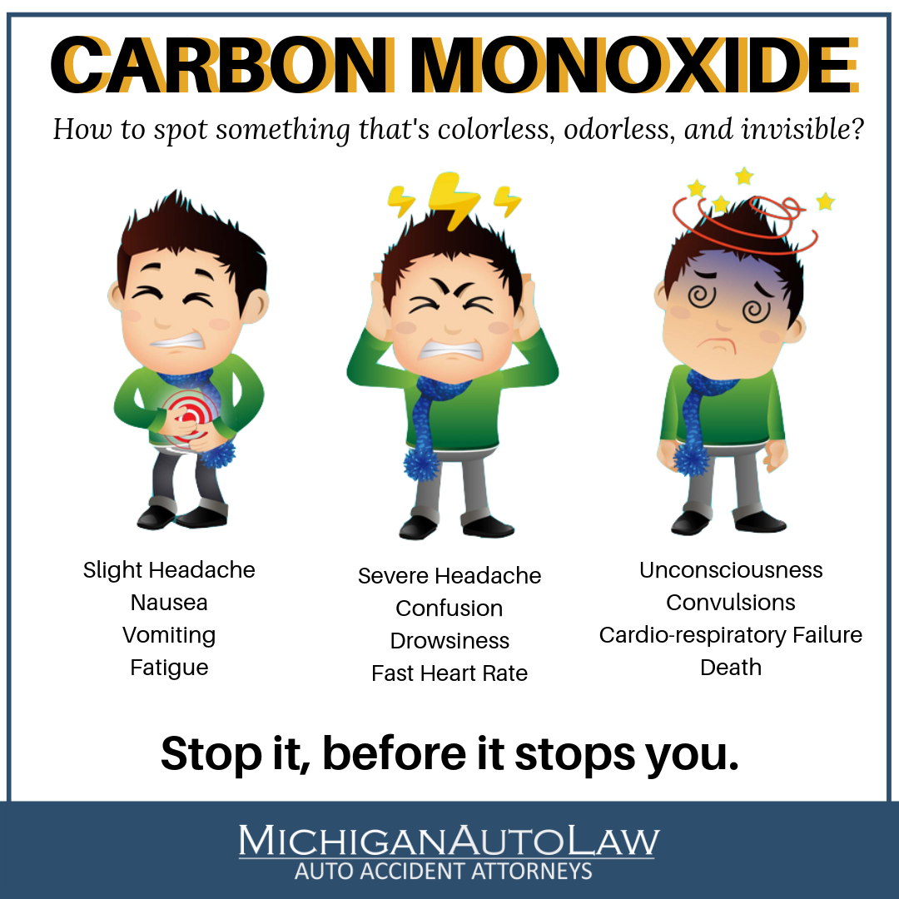
Carbon Monoxide
It is a colorless, odorless gas which is produced when carbon does not burn completely in fossil fuels.
Mostly present in car exhausts.
It deprives body of Oxygen causing headaches, fatigue and impaired vision.

Slide 6
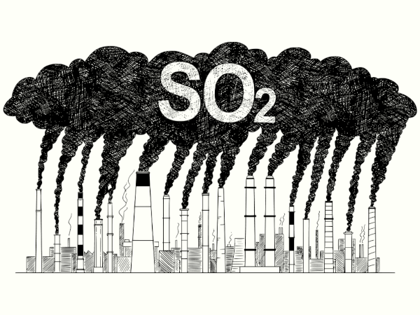
Sulfur Dioxide
This gaseous Is produced when coal and fuel oil are burnt.
Mostly present in power plant exhaust.
Causes wheezing and shortness of breath, especially in
those with asthma.

Slide 7
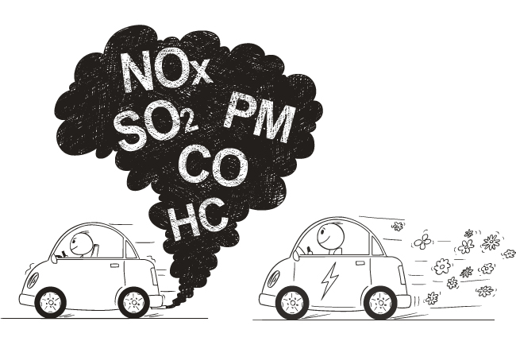
Nitrogen Dioxide
This reddish, brown gas is produced when nitric oxide
combines with oxygen in the atmosphere.
It is present in car exhaust and power plants.
It causes wheezing and respiratory infection.

Slide 8
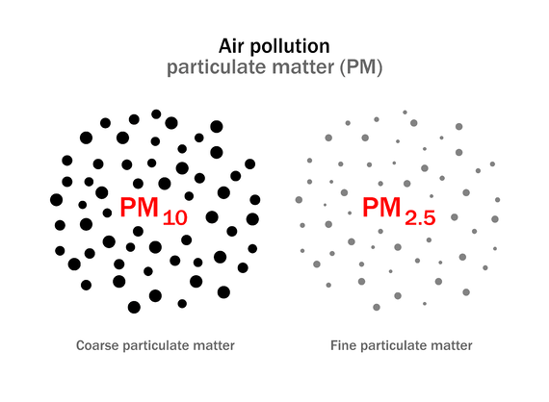
Particulate Matter
Refers to the particles of different sizes and structures that
are released into the atmosphere during the burning of
fossil fuels, construction activity, fog, sand storm etc.
It can aggravate heart and lung disease; may increase risk
of respiratory infection.

Slide 9
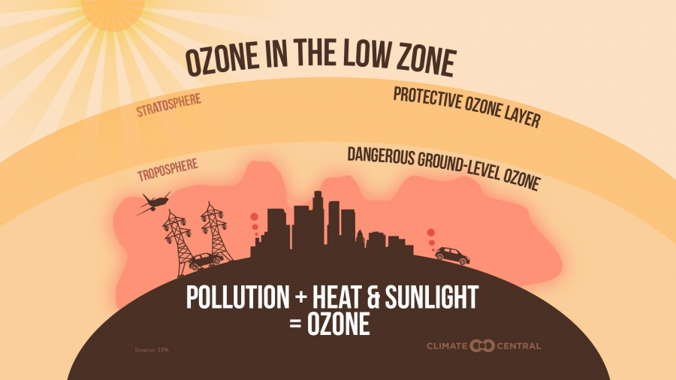
Ground Level Ozone
In upper layers of atmosphere, ozone shields Earth form
sun’s harmful Ultra Violet rays. At ground level though,
ozone is a harmful pollutant.
It is produced in car, power and chemical plant exhaust.
May irritate respiratory system and asthma; reduces lung
function.

Slide 10



